Slide 1

Inventory management system overview
Jabaran Khan

Slide 2
Introduction
Hello, my name is Jabaran Khan. I will be showing the code I have been working on for the past few days in regards to the Inventory management system that I have been working on for the past week.
In this presentation I will go over what I did to prepare me for the project and what the main challenges were going into the project and what I did to tackle them.
I will be showing the progress of my project and highlight some code that I was able to do as well as go over any risks and plans I had.
The main things I will discuss at the end will be what I learned and what things I wanted to add the project.
Notes:
Overview of code

Slide 3
Using the Agile/Jira model
Here I will talk about how I used the Agile/Jira model to plan this project and create story points along the journey a long the way. I will demonstrate this on my screen now.
Link to model: here.
This was a great model to use, it was done for self work but it benefitted me so I knew what to do and plan to meet the minimum requirement for the project.
I planned the project back in Week 1 and 2 as what we covered there was basically the Agile framework and how it works. As the weeks went by and the information increased. I knew this would be on the back of my mind. I made the choice to do a small framework back then to help me now.

Slide 4
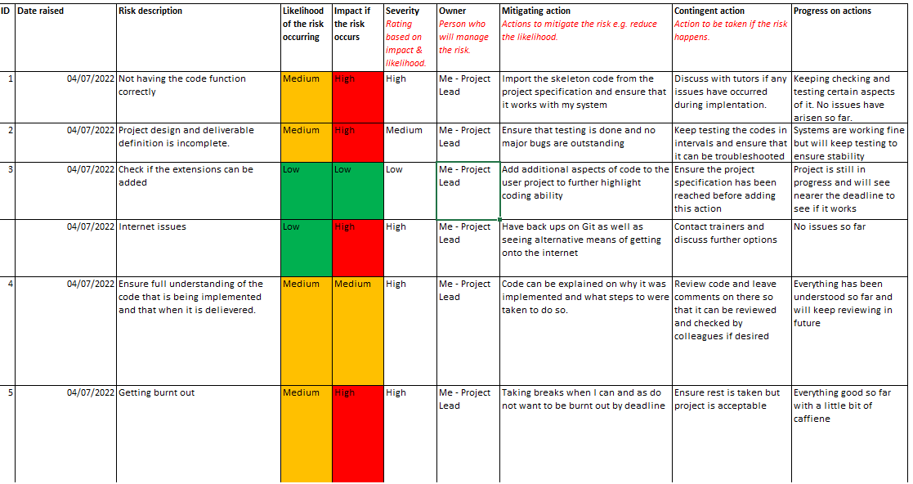
The risks during the project
Here is a risk assessment table on what issues and risks might arise during the project week. As it was only me doing the project – I created the table. I wanted to get into the habit of doing these when/if I get assigned group work.
Notes:
What the main risks were going into the project

Slide 5
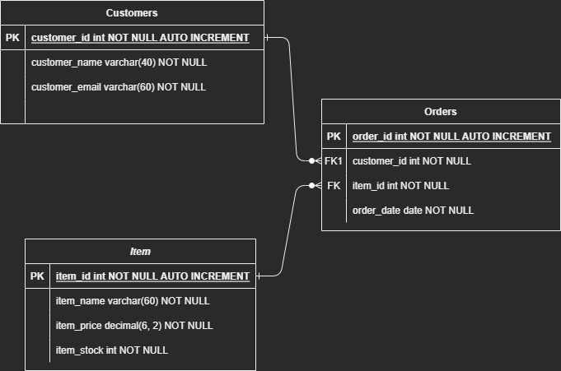
Entity Relationship Diagram
Here you will be able to see the ERD that was created for the project. This is the first one that was made and it changed quite a bit from the project start to now. I will show the updated shortly.
This was the general idea I wanted to do when I started this project on a fundamental level.

Slide 6
The project
Here I will show a demonstration on how the project works. Please bear in mind that while it is mainly finished there will be some things that will need to be ironed out and cleaned up.
The biggest issues I mainly had going into this was understanding the skeleton code. While it was great having a basis to go in. There were hardly any comments. However the way I tackled this was to look online for what things did if I didn’t understand of if it didn’t run. StackOverflow, QA Communities and w3schools were the main sources of information. Youtube also helped on quite a few things.
Another issue would have been understanding and integrating SQL and Java. These 2 languages are new to me and I am still understanding and learning the intricacies of them. Again looking online and seeing if people have encountered any of these issues helped me solve most of the issues.

Slide 7
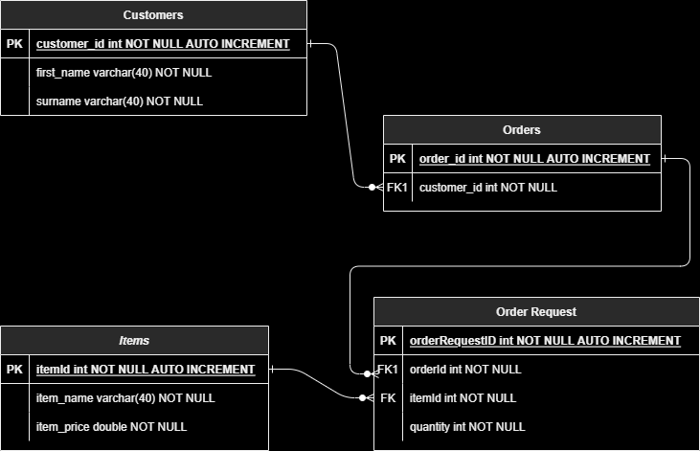
Updated Entity Relationship Diagram
As you can see here the ERD went through get a few changes. This is the final version that was used. On the project it stated at least 3 but it was much easier to manage and implement using 4 tables and then creating relationships that way.

Slide 8
What would I do different?
Things to work on for myself is having more understanding of Java and SQL. This project helped boost that as it was a good challenge to test the knowledge I have learnt. However there were some areas that I didn’t feel confident in.
Try the additional work that was the user log in system. I wanted to have a go at this at least but due to problems that started up. I wasn’t able to do this on time.
Try and plan it better and be more cautious of issues. I am still currently working through the testing phase. I wanted this to be done and cleared but was unable to.

Slide 9
Any questions?
Thank you for taking the time to watch me demonstrate my code – please let me know if there are any questions that you will like me to cover.

